Slide 1
CS-1002 Programming fundamentals
Instructor : Aqib Rehman
aqib.rehman@isb.nu.edu.pk
Fall 2023
FAST National University of Computer and Emerging Sciences, Islamabad

Slide 2
What We covered in Last lectures

Slide 3
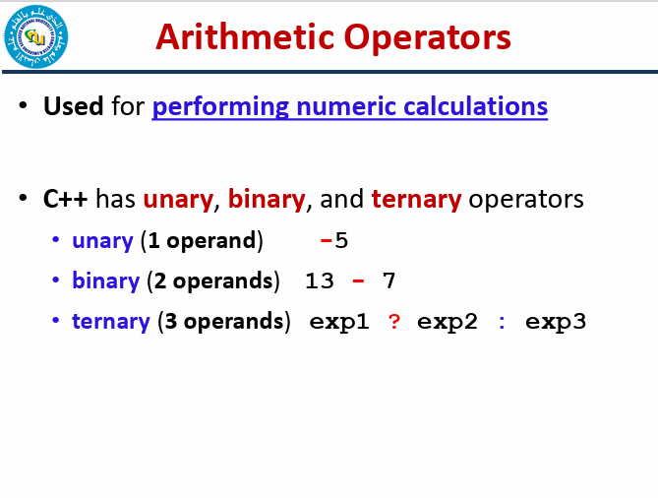

Slide 4
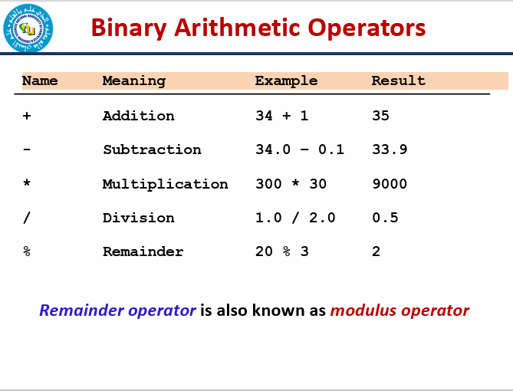

Slide 5
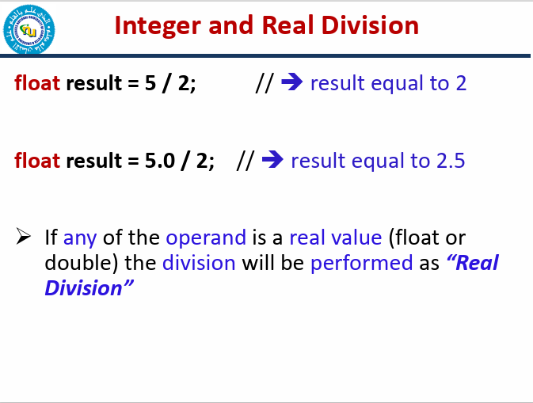

Slide 6
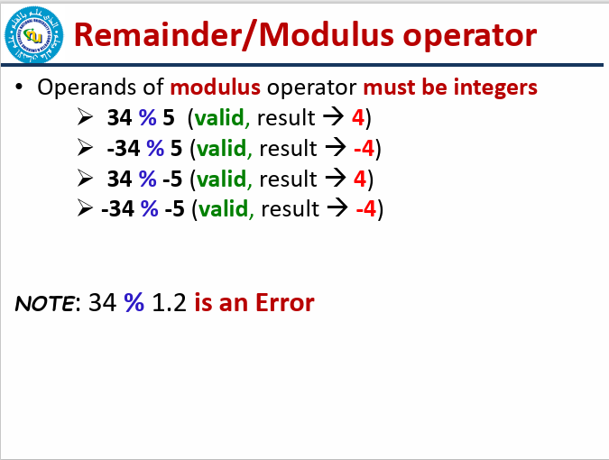

Slide 7
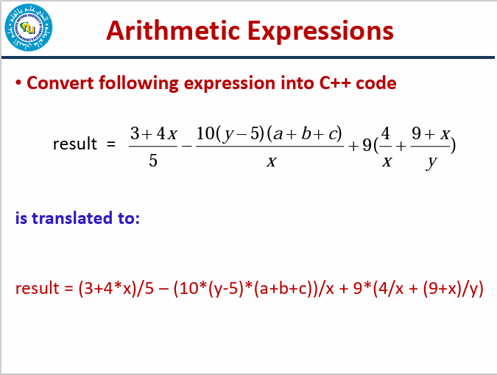

Slide 8
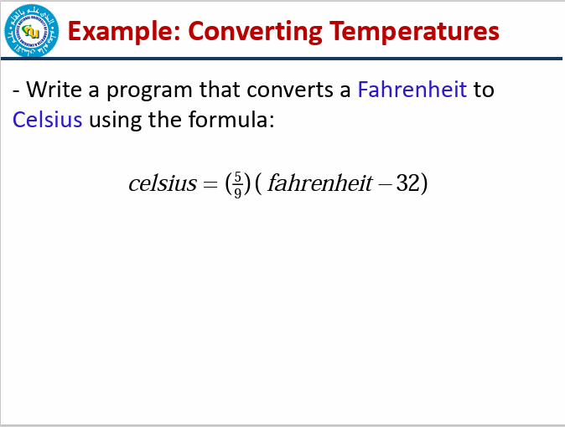

Slide 9
Todays Lecture

Slide 10
Multiple Assignment

Slide 11
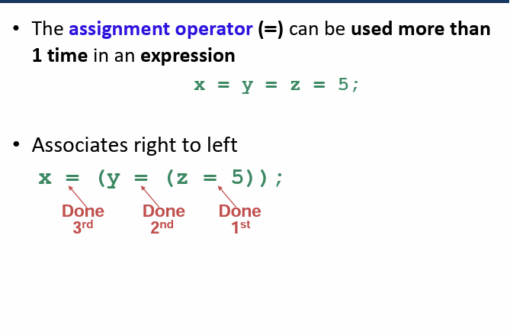

Slide 12
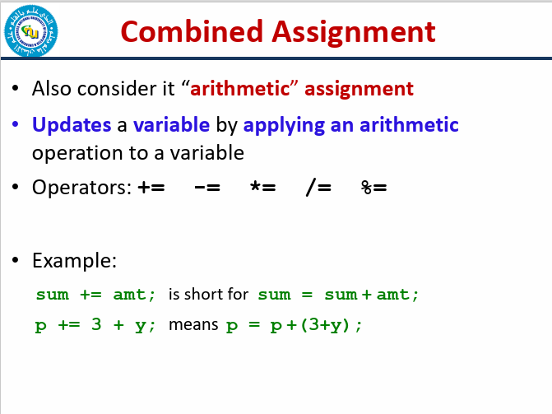

Slide 13
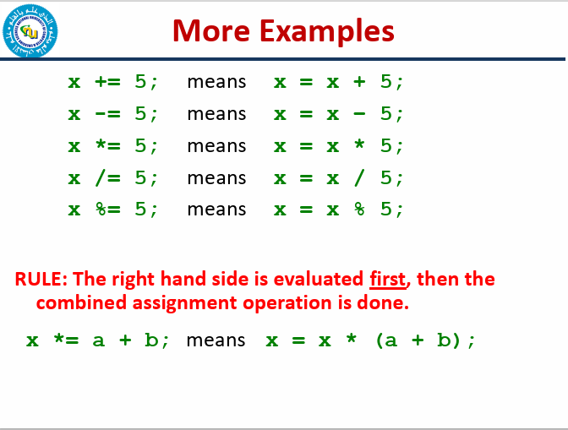

Slide 14
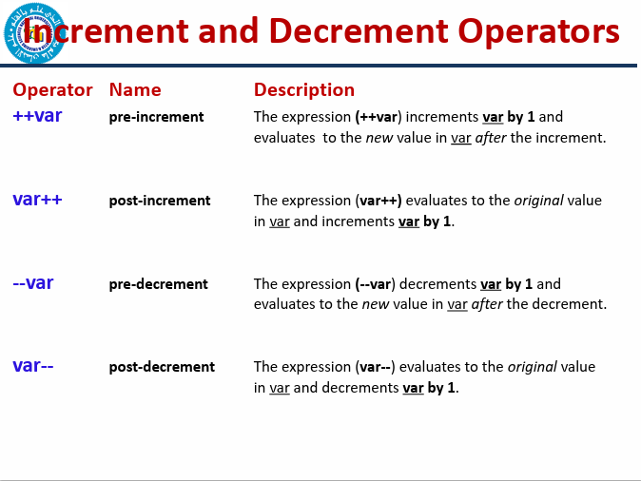

Slide 15
Evaluate the followings:
int val = 10;
int result = 10 * val++;
cout<<val<<“ “<<result;
int val = 10;
int result = 10 * ++val;
cout<<val<<“ “<<result;
Output
11 100
11 110

Slide 16
Output of the following code:
#include <iostream>
using namespace std;
int main()
{
int x = 5, y = 5, z;
x = ++x;
y =--y;
z = x++ + y--;
cout << z<<endl;
cout << x<<endl;
cout << y<<endl;
return 0;
}
Output
10
7
3

Slide 17
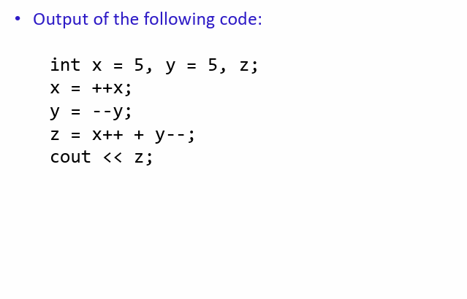

Slide 18
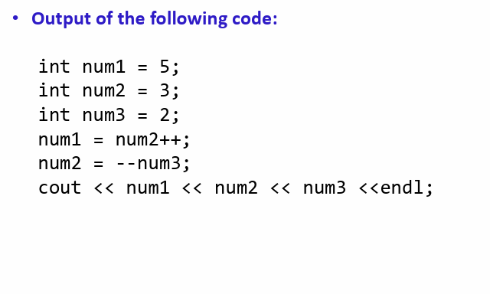

Slide 19
Equality and Relational Operators
Equality Operators:
Operator
==
!=
Example x == y x != y
Meaning
x is equal to y
x is not equal to y
Relational Operators:
Operator | Example | Meaning
> | x > y | x is greater than y
< | x < y | x is less than y
>= | x >= y | x is greater than or equal to y
<= | x <= y | x is less than or equal to y

Slide 20
Logical Operators
Logical operators are useful when we want to test multiple conditions
Three types:
  boolean AND
  boolean OR
  boolean NOT

Slide 21
Boolean AND or logical AND
Symbol: &&
All the conditions must be true for the whole expression to be true
– Example:
if ( (a == 10) && (b == 10) && (d == 10) )
{
cout<<“a, b, and d are all equel to 10”;
}

Slide 22
Boolean OR / Logical OR
Symbol: ||
ANY condition is sufficient to be true for the whole expression to be true
– Example:
if (a == 10 || b == 9 || d == 1)
{
// do something
}

Slide 23
Boolean NOT/ Logical NOT
Symbol: !
Reverses the meaning of the condition (makes a true condition false, OR a false condition true)
– Example:
if ( ! (marks > 90) )
{
// do something
}

Slide 24
Bitwise Operators (integers)
Bitwise "and" operator &
Bitwise "or" operator |
Bitwise "exclusive or" operator ^
– (0 on same bits, 1 on different bits)
Bitwise "ones complement" operator ~
Shift left <<
Shift right >>
66

Slide 25
Bitwise Operators (Example)
int i = 880; ➔ | 1 | 1 | 0 | 1 | 1 | 1 | 0 | 0 | 0 | 0
int j = 453; ➔ | 0 | 1 | 1 | 1 | 0 | 0 | 0 | 1 | 0 | 1
i & j (320) | 0 | 1 | 0 | 1 | 0 | 0 | 0 | 0 | 0 | 0
i | j (1013) | 1 | 1 | 1 | 1 | 1 | 1 | 0 | 1 | 0 | 1
i ^ j (693) | 1 | 0 | 1 | 0 | 1 | 1 | 0 | 1 | 0 | 1
~j (-454) | 1 | 0 | 0 | 0 | 1 | 1 | 1 | 0 | 1 | 0
i = i<<1; (1760) | 1 | 0 | 1 | 1 | 1 | 0 | 0 | 0 | 0 | 0
i = i>>1; (440) | 0 | 1 | 1 | 0 | 1 | 1 | 1 | 0 | 0 | 0
unsigned int

Slide 26
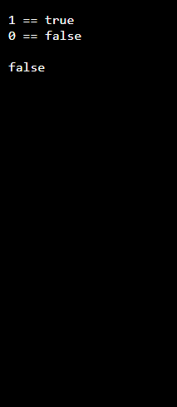
Boolaplha
#include <iostream>
using namespace std;
int main() {
bool t = true;
bool f = false;
cout << noboolalpha << t << " == " << boolalpha << t << endl;
cout << noboolalpha << f << " == " << boolalpha << f << endl;
cout<<endl;
bool a =0;
cout<<boolalpha<<a;
return 0;
}
Output

Slide 27
Type Casting

Slide 28
Type Coercion
Coercion: automatic conversion of an operand to
another data type
Promotion: converts to a higher type
float p; p = 7; ➔ 7 (int) converted to float 7.0
Demotion: converts to a lower type
int q; q = 3.5; ➔ 3.5 (float) converted to int 3

Slide 29
Coercion Rules
1) char, short, unsigned short are promoted to int
automatically
When operating on values of different data types, the
lower one is promoted to the type of the higher one.
For the assignment operator = the type of expression on right will be converted to the type of variable on left

Slide 30
Typecasting
A mechanism by which we can change the data type of a variable (no matter how it was originally defined)
Two ways:
  Implicit type casting (done by compiler)
  Explicit type casting (done by programmer)

Slide 31

In this example the integer value 55 is converted to a floating-point value (most likely double) of 55.0. It was promoted.

Slide 32
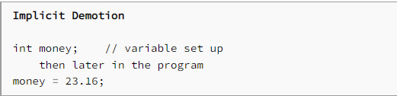
In this example the variable money is an integer. We are trying to move a floating-point value 23.16 into an integer storage location. This is demotion and the floating-point value usually gets truncated to 23.

Slide 33

This expression would evaluate to: 4.

Slide 34
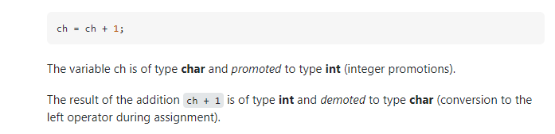

Slide 35
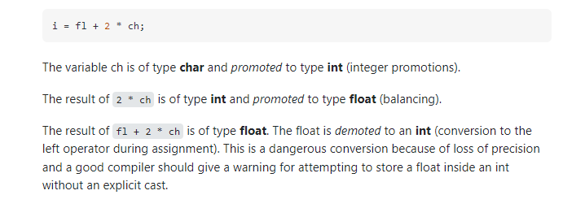

Slide 36
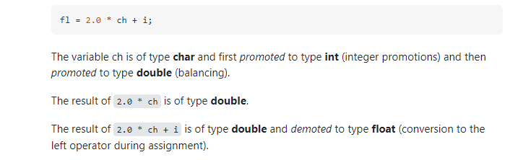

Slide 37
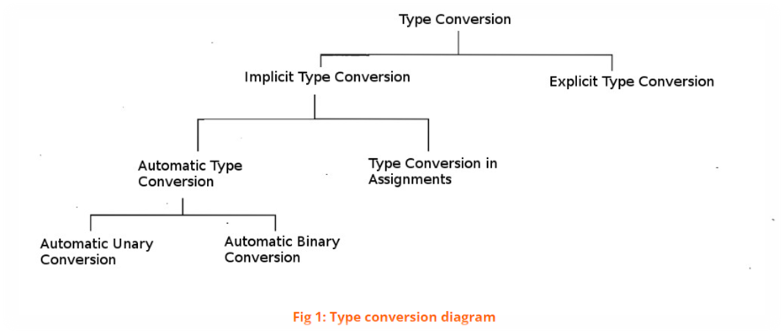

Slide 38
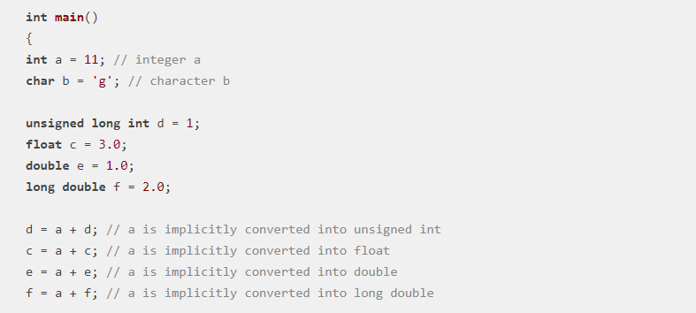

Slide 39
Implicit type casting
As seen in previous examples:
void main( )
{
char c = 'a'; float f = 5.0; float d = c + f;
cout<<d<<“ “<<sizeof(d)<<endl; cout<<sizeof(c+f);
}

Slide 40
Numeric Type Conversion
Consider the following statements:
short i = 10;
long k = i * 3 + 4;
double d = i * 3.1 + k / 2; cout<<d;

Slide 41
Type Conversion Rules
Auto Conversion of Types in C++
If one of the operands is long double, the other is converted into long double
Otherwise, if one of the operands is double, the other is
converted into double.
Otherwise, if one of the operands is unsigned long, the other is converted into unsigned long.
Otherwise, if one of the operands is long, the other is
converted into long.
Otherwise, if one of the operands is unsigned int, the other is
converted into unsigned int.
Otherwise, both operands are converted into int.

Slide 42
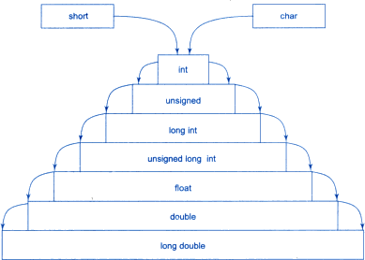
Implicit Type Conversion in C++

Slide 43
Overflow and Underflow
When a variable is assigned a value that is too large or too small in range:
  Overflow
  Underflow
– After overflows/underflow values wrap around the maximum or minimum value of the type

Slide 44
Example
// testVar is initialized with the maximum value for a short.
short int testVar = 32767;
// Display testVar.
cout <<"\nOrignal value: "<<testVar <<endl;
// Add 1 to testVar to make it overflow. testVar = testVar + 1;
cout <<"\nValue Overflow +1: "<<testVar << endl;
// Subtract 1 from testVar to make it underflow.
testVar = testVar - 1;
cout <<"\nValue underflow -1: "<<testVar << endl;

Slide 45

Example
// testVar is initialized with the maximum value for a short.
short int testVar = 32767;
// Display testVar.
cout <<"\nOrignal value: "<<testVar <<endl;
// Add 1 to testVar to make it overflow. testVar = testVar + 1;
cout <<"\nValue Overflow +1: "<<testVar << endl;
// Subtract 1 from testVar to make it underflow.
testVar = testVar - 1;
cout <<"\nValue underflow -1: "<<testVar << endl;

Slide 46
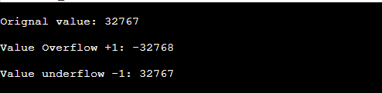
Example
// testVar is initialized with the maximum value for a short.
short int testVar = 32767;
// Display testVar.
cout <<"\nOrignal value: "<<testVar <<endl;
// Add 1 to testVar to make it overflow. testVar = testVar + 1;
cout <<"\nValue Overflow +1: "<<testVar << endl;
// Subtract 1 from testVar to make it underflow.
testVar = testVar - 1;
cout <<"\nValue underflow -1: "<<testVar << endl;

Slide 47
Explicit type casting
Explicit casting performed by programmer. It is performed by using cast operator
float a=5.0, b=2.1;
int c = a%b; // → ERROR
Three Styles
int c = (int) a % (int) b; int c = int(a) % int(b);
//C-style cast
// Functional notation
int c = static_cast<int>(a) % static_cast<int>(b); cout<<c;

Slide 48
Explicit Type Casting
- Casting does not change the variable being cast.
For example, d is not changed after casting in the following code:
double d = 4.5;
int j = (int) d; //C-type casting
int i = static_cast<int>(d); // d is not changed cout<<j<<“ “<<d;

Slide 49
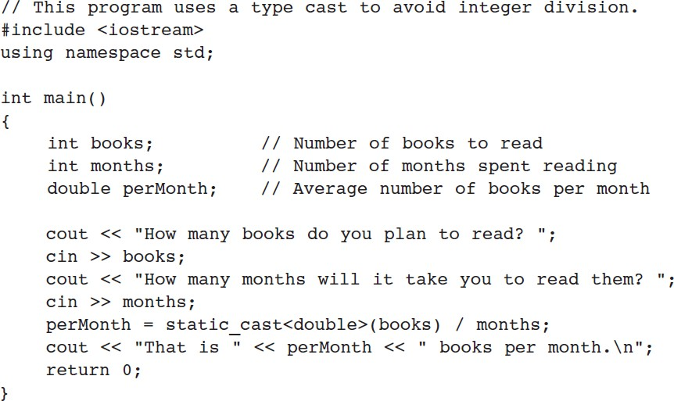
Explicit Type Casting - Example

Slide 50
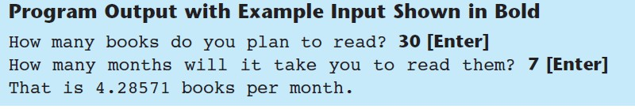
Explicit Type Casting - Example

Slide 51
Widening type casting
A "widening" cast is a cast from one type to another, where the "destination" type has a larger range or precision than the "source“
Example:
int i = 4; double d = i;

Slide 52
Narrowing type casting
A “narrowing" cast is a cast from one type to another, where the "destination" type has a smaller range or precision than the "source“
Example:
double d = 787994.5; int j = (int) d;
// or
int i = static_cast<int>(d);

Slide 53
Casting between char and Numeric Types
int i = 'a';
// Same as
int i = (int) 'a';
char c = 97;
// Same as
char c = (char)97;

Slide 54
Using ++, -- on “char” type
- The increment and decrement operators can also be applied on char type variables:
-Example:
char ch = 'a'; cout << ++ch;

Slide 55
THANK YOU
QUESTIONS

Slide 56
Algebraic Expressions
Multiplication requires an operator
Area = lw is written as Area = l * w;
There is no exponentiation operator
Area = s² is written as Area = pow(s, 2); (note: pow requires the cmath header file) OR Area = s*s;
Parentheses may be needed to maintain order of operations
y2 − y1
m =
is written as: m = (y2-y1)/(x2-x1);
x2 − x1

Slide 57
Precedence Rules – Example 1
6 + 2 * 3 - 4 / 2
6 + 6 - 4 / 2
6 + 6 - 2
12 - 2
10

Slide 58
Precedence Rules – Example 2
3 * 4 / 2 + 3 - 1
12 / 2 + 3 - 1
6 + 3 - 1
9 - 1
8

Slide 59
Precedence Rules – Example 3
8 * 3 / 2 + 3 - 1
24 / 2 + 3 - 1
12 + 3 - 1
15 - 1
14
8 / 3 * 2 + 3 - 1
2 * 2 + 3 - 1
4 + 3 - 1
7 - 1
6

Slide 60
Precedence Rules (overriding)
For example: x = 3 * a - ++b % 3;
If we intend to have the statement evaluated differently from the way specified by the precedence rules, we need to specify it using parentheses ( )
Using parenthesis:
x = 3 * ((a - ++b)%3);

